Slide 1
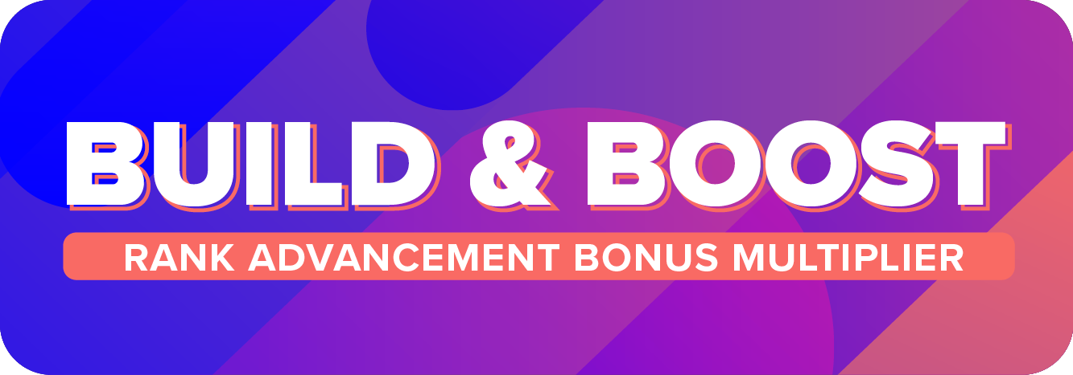

Slide 2
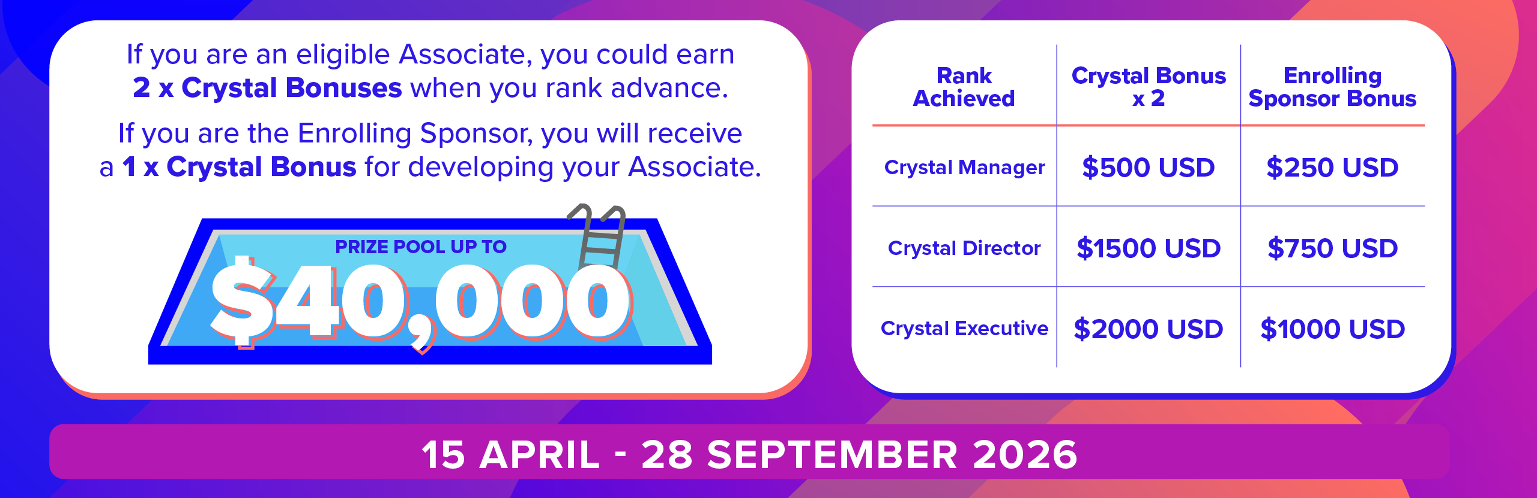

Slide 3
Who is eligible for the 2x Crystal Bonus?
Preferred Customers who have not previously converted to Associate, regardless of join date
Associates/Consultants who converted to Associate on or after 4:01pm AEDT 29 December, 2025
ANZ Member who are currently within their Crystal Timeframes
Notes:
Thomasina – my suggestion would be to animate each line to come up one at a time. Then I will add a slide for each scenario.
So each line appears first, then circle the first one and we explain that one. Then we go back to this page (I will duplicate) and circle the second one etc.

Slide 4

Preferred Customers who have not previously converted to Associate
Creates 2 Consultants and rank advances to MANAGER within 60 Days of conversion
$500USD
Bonus
Creates 4 more Consultants and rank advances to DIRECTOR within 120 Days of conversion
$1500USD
Bonus
Currently Preferred Customer
Converts to Associate
Creates 4 more Consultants and rank advances to EXECUTIVE within 180 Days of conversion
$2000USD
Bonus
THESE BONUSES STACK! You could earn $4000USD

Slide 5
Who is eligible for the x2 Crystal Bonus?
Preferred Customers who have not previously converted to Associate, regardless of join date
Associates/Consultants who converted to Associate on or after 4:01pm AEDT 29th December, 2025
ANZ Member who are currently within their Crystal Timeframes
Notes:
Thomasina – my suggestion would be to animate each line to come up one at a time. Then I will add a slide for each scenario.
So each line appears first, then circle the first one and we explain that one. Then we go back to this page (I will duplicate) and circle the second one etc.

Slide 6
Current Rank: Associate/Consultant
Rank advance to Manager within 60 Days of 2:01pm AEST 15 April, 2026
$500USD
Bonus
Rank advance to Director within 120 Days of 2:01pm AEST 15 April, 2026
$1500USD
Bonus
Converted to Associate
(On or after 4:01pm AEDT
29th Dec 2025)
Crystal Timeframes reset as of
2:01pm AEST
15th April 2026
Rank advance to Executive within 180 Days of 2:01pm AEST 15 April, 2026
$2000USD
Bonus

Slide 7
Who is eligible for the 2x Crystal Bonus?
Preferred Customers who have not previously converted to Associate, regardless of join date
Associates/Consultants who converted to Associate on or after 4:01pm AEDT 29 December 2025
ANZ Member who are currently within their Crystal Timeframes
Notes:
Thomasina – my suggestion would be to animate each line to come up one at a time. Then I will add a slide for each scenario.
So each line appears first, then circle the first one and we explain that one. Then we go back to this page (I will duplicate) and circle the second one etc.

Slide 8
ANZ Members within Crystal Timeframe
Rank advance to Crystal Manager by 30 April, 2026. (60 Days from conversion)
$500USD
Bonus
EXAMPLE
Rank advance to Crystal Director by 29 June, 2026. (120 Days from conversion)
$1500USD
Bonus
Converted to Associate
on 1st March 2026
Rank advance to Crystal Executive by 28 August, 2026. (180 Days from conversion)
$2000USD
Bonus

Slide 9
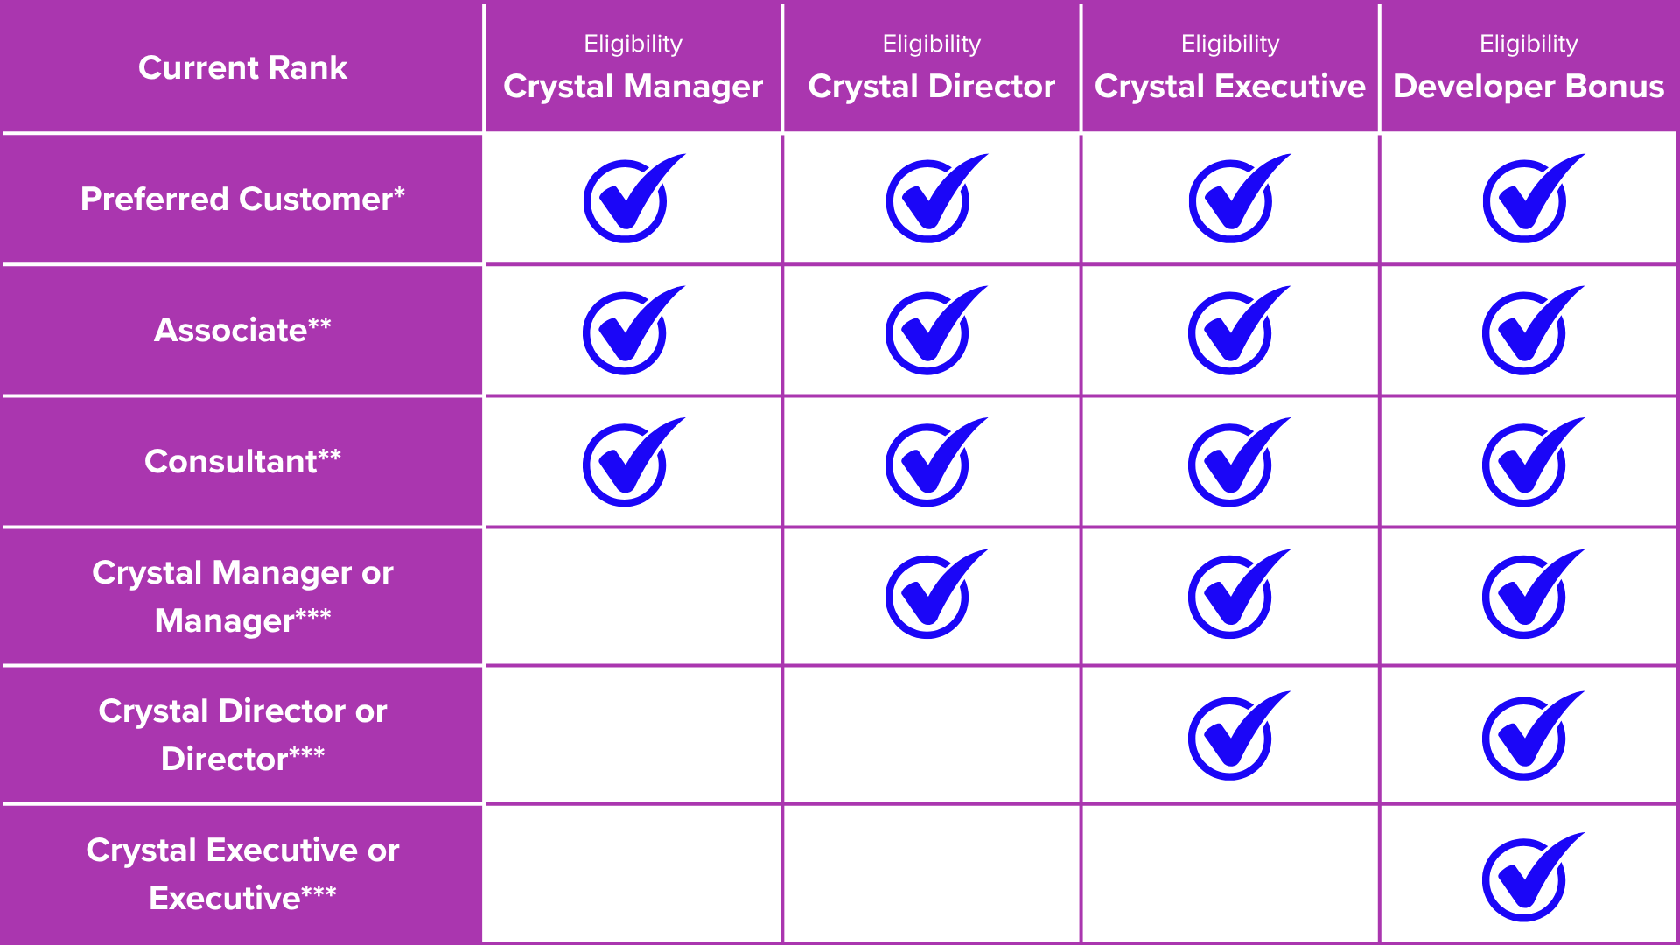

Slide 10
Who is eligible for the Enrolling Sponsor Bonus?
Enrolling Sponsors who have met the following criteria
Has a Member in their personally enroled team who has qualified for the 2 x Crystal Bonus
Personally qualified for the Team Builders Bonus
Registered and hosted an official Opportunity Meeting within the applicable commission month

Slide 11

How do I register an Opportunity Meeting successfully?
Hosts must register their event with Thomasina at a minimum of 2 weeks in advance of the event date. This allows enough time to organise any flyers, product support or general event support that is requested.
The following details must be provided in your request:
Date/Time of Event
Location
Type of Event
  Face to Face
  Virtual
  Co-Hosted*
Theme or Title of Event
Focus of the Event
Expected number of guests (to be provided to Thomasina 5 business days before event date)
Any requests for product samples, printed catalogues or any shipping that’s required
MUST BE NO LATER THAN 5 BUSINESS DAYS
before your event date
In-home events
Market stalls
Expos
Sports events (e.g. run groups, yoga session)
Activities (e.g. arts & crafts, cooking class)
Webinars
One-on-one meetings
Team calls with existing members

Slide 12
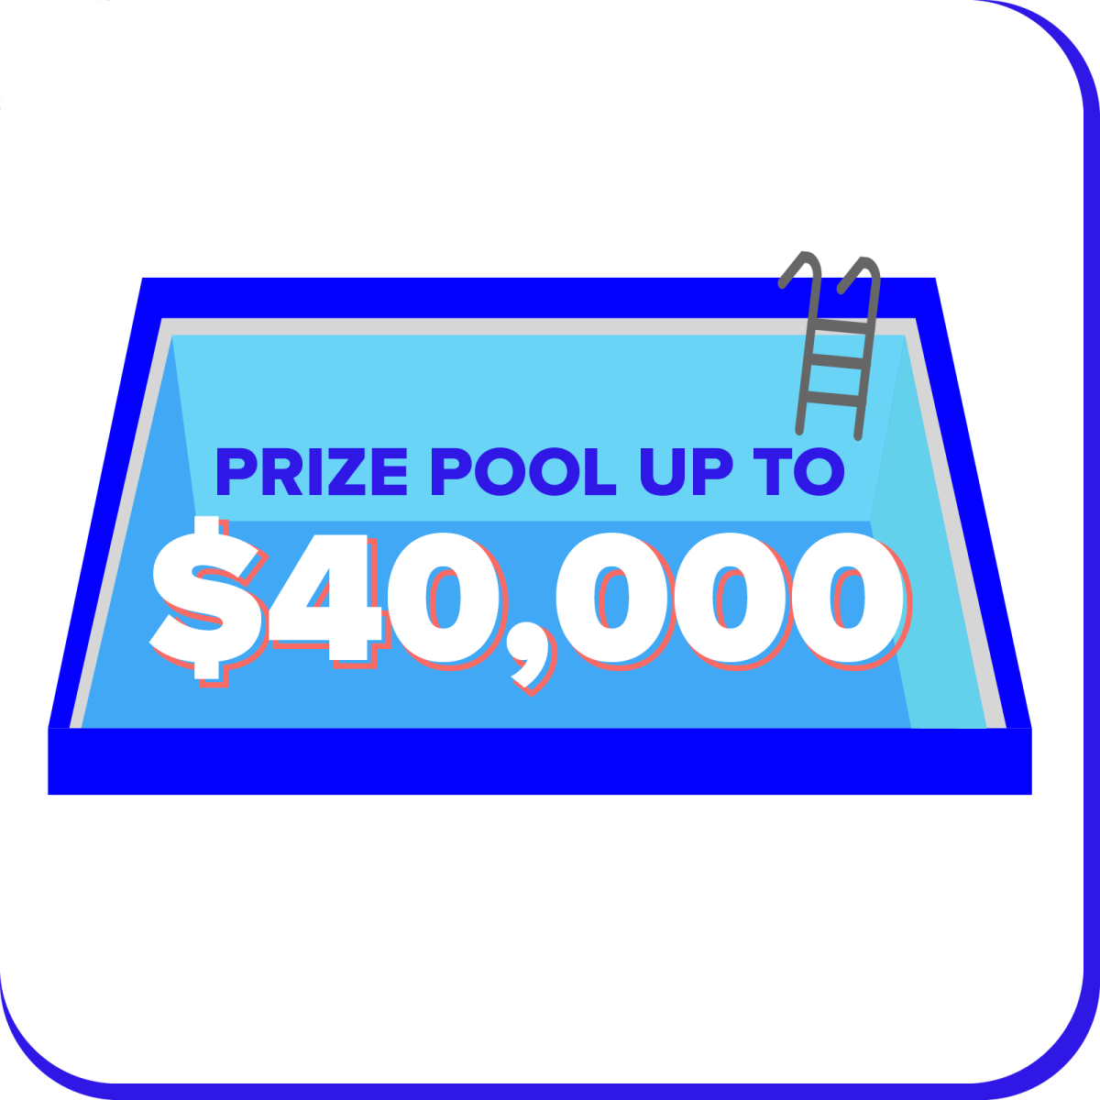
Once this amount has been awarded in Bonuses,
the promotion will END
regardless of the projected end date of 28 September, 2026
Once it’s gone, it’s gone!

Slide 13
How and when will the Bonuses be paid?
2x Crystal Bonuses will be paid 1 week in arears from the date of the advancement
Example:
Rank Advanced to Manager on Wednesday 21st April, they would be paid for this Bonus in the Monday 4th May commission pay run
1x Enrolling Sponsor Bonuses will be paid on the Monday closest to the 15th of the commission month following the qualified personally enroled rank advancement
Same monthly pay run as Team Builders Bonus

Slide 14
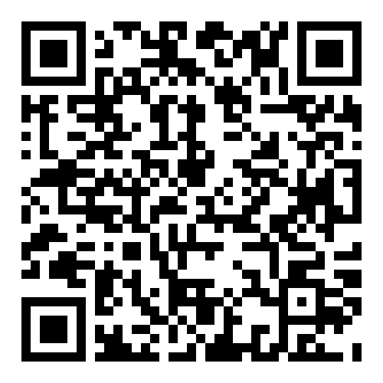
Build & Boost on ANZ Business
CUSTOMER SERVICE
Customer orders
Delivery updates
Login and IT issues
IsaLife App
Coupons
Compliance
Rank history
KATE
Back Office
Reporting
Commissions
Compensation plan
Kickstart90
THOMASINA
Opportunity Meeting support
(flyers, samples, etc)
Promotions & offers
Brand Partner
Coaching
EleVate
Product updates

Slide 15

Q&A

